Slide 1
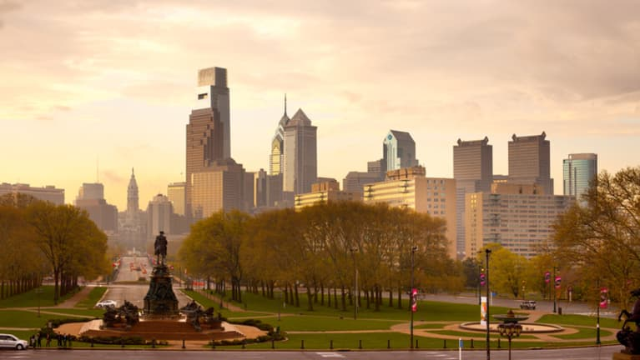
Crimes in Philadelphia
Raj Patel, Hong Son, Kunal Sharma

Slide 2



Goals
Identify what data set attributes correlate to the different types of crime
Learn and implement new approaches to machine learning
Create multiple models to predict the likelihood of a crime and type of crime in Philadelphia
Equip law enforcement with intelligence to effectively combat crime proactively
Extend our work from last term to add to our portfolio

Slide 3


Datasets
Philadelphia Crime Data:
Published by OpenPhillyData
Dates from 12-31-05 to 03-22-17 (majority of the dates are from 2006-2016)
Attributes include the district number, sector, dispatch date, dispatch time, location, general code, descriptions of the crime, and the district
There are 14 total columns and ~4400 in this dataset.
Philadelphia Weather Data:
Published by Pennsylvania State Climatologist
Dates from 2007 to 2018
The dataset includes the temperatures in Fahrenheit, the max and min temperature, environment information, wind, and precipitation.
The data was formatted from PDF files and a dataset was formed [~4,000 rows and 15 columns].
Notes:
Hong

Slide 4

Datasets
Parking Violation Dataset:
Published by OpenPhillyData
Dates from 2012-Present
Attributes include: anon_ticket_number, issue_datetime, state, anon_plate_id, division, location, violation_desc, fine, issuing_agency,lat,lon,gps,zip_code
There are 13 total columns and ~5.8 million in this dataset.
Notes:
Hong

Slide 5
Schedule | Task | Ownership | Status
Week 1 | Weekly Team meeting to Discuss Project | Team | DONE
Week 2 | Data science capstone project launch report (Use DSCI 591 template) | Team | DONE
Week 3 | Outline and steps to accomplish the capstone, Identifying Data Sources project | Raj | DONE
Week 4 | Start coding in Python and/or R | Team | IN PROGRESS
Week 5 | Pitch Presentation | Raj | IN PROGRESS
Week 6 | Data Acquisition, Pre-processing and EDA report (Use DSCI 591 template) | Hong | IN PROGRESS
Week 7 | Applying Machine Learning Models | Kunal | IN PROGRESS
Week 8 | Model Evaluation and make the model better - Data transformation/Normalization - Dimensionality reduction (PCA as an example) - Hyper-parameter tuning (for example gamma and C for SVM) - Feature Selection
Week 9 | Predictive modeling report (Find its template on Blackboard)
Week 10 | Final Project Presentation
Notes:
Hong

Slide 6


Github
Outline
https://github.com/hongson1218/Crime-in-Philadelphia/tree/master/Winter%2020-21
https://docs.google.com/document/d/1eEpdV3BgqS91CuR99-xUVGApz10vJLTh5tm3rUzxBzA/edit?usp=sharing
Notes:
Hong

Slide 7
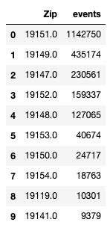
Exploratory data analysis
What are the top 10 zip codes where crime occured?
From our analysis we can see that the top 10 zip codes are [in order]
19151, 19149, 19147, 19152, 19148, 19153, 19150, 19154, 19119, 19141
Overbrook, Oxford Circle, Bella Vista|Wharton, Rhawnhurst, Pennsport, Tank Farms and Refineries|Eastwick, Cedarbrook|Mount Airy, West Torresdale,

Slide 8
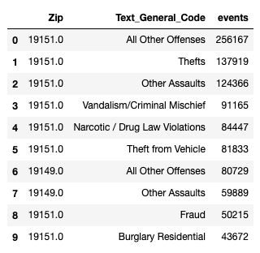
Exploratory data analysis
What are the top 10 crimes that occured with Zip Code factored in?
From our analysis we can see that there are multiple cases of crimes at 19151. Two instances with crime in 19149 also made the counts.

Slide 9
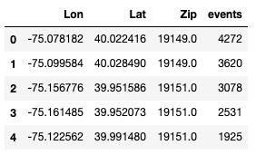
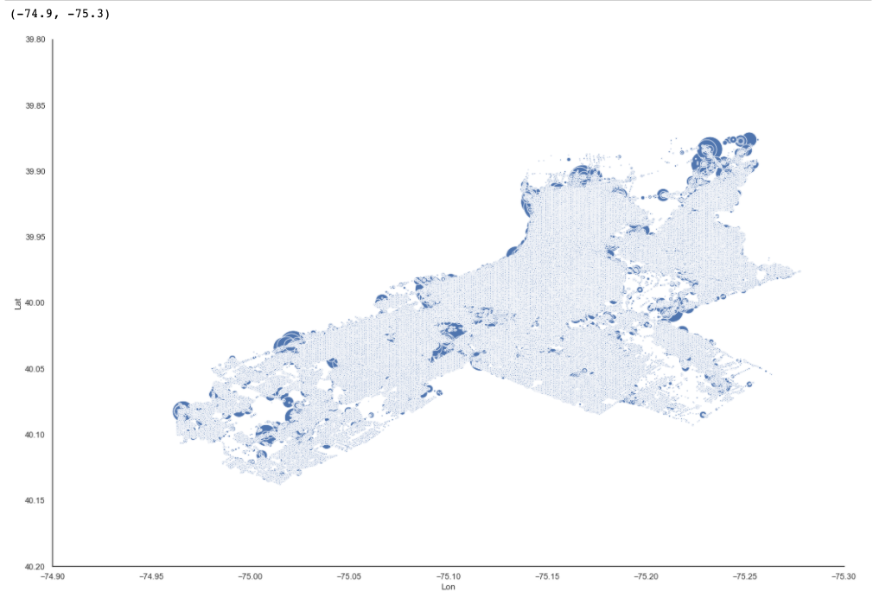
Exploratory data analysis
Regions with the most crime?
We found it interesting that when we consider Lon, Lat, and Zip that the most events happened in 19149.

Slide 10
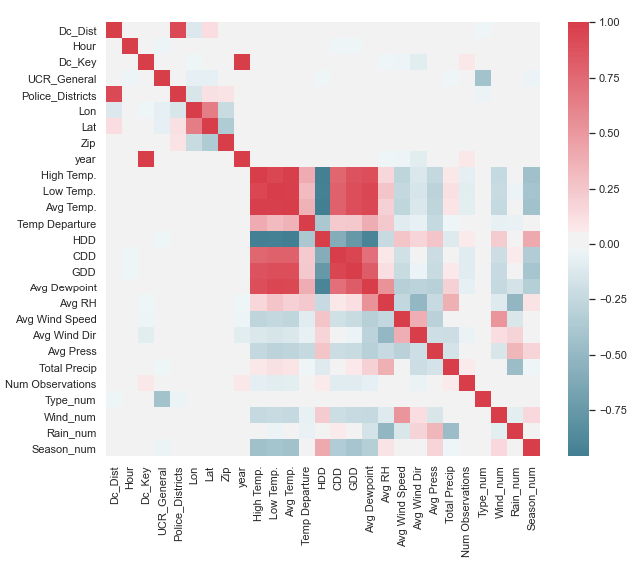
Exploratory data analysis
Is there any interesting correlations?
We didn’t find mant correlation for the whole dataset in general

Slide 11
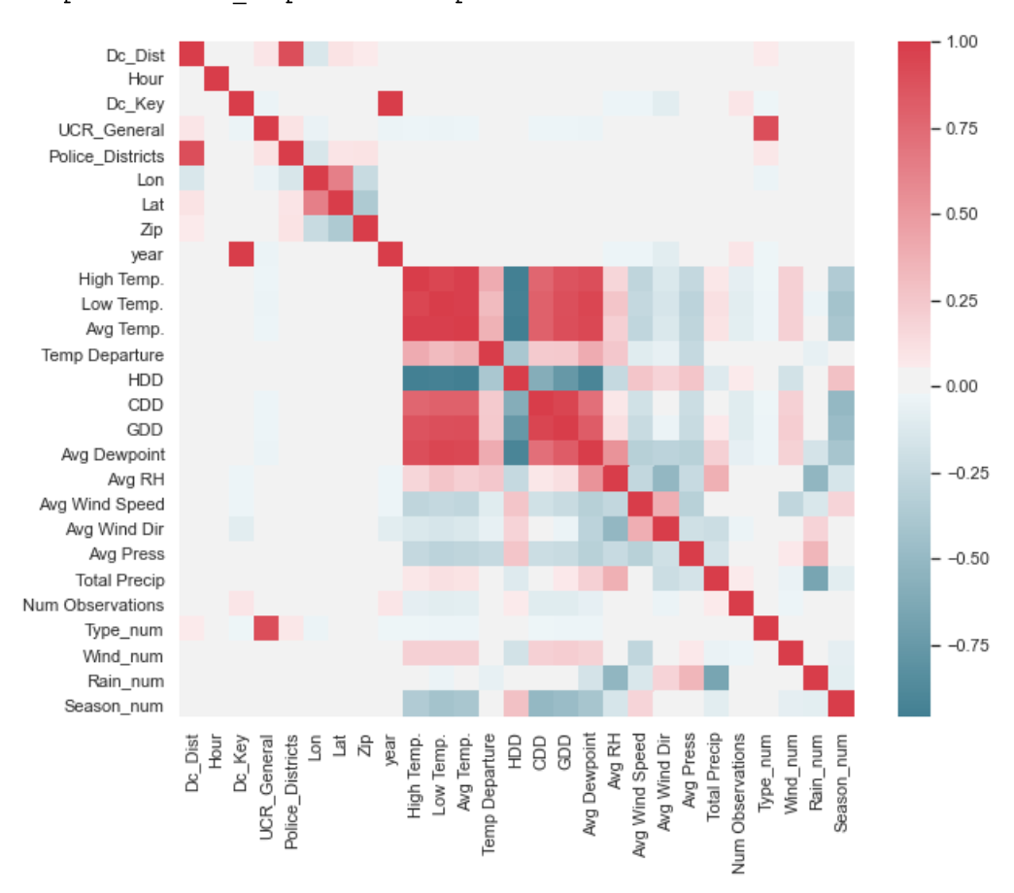
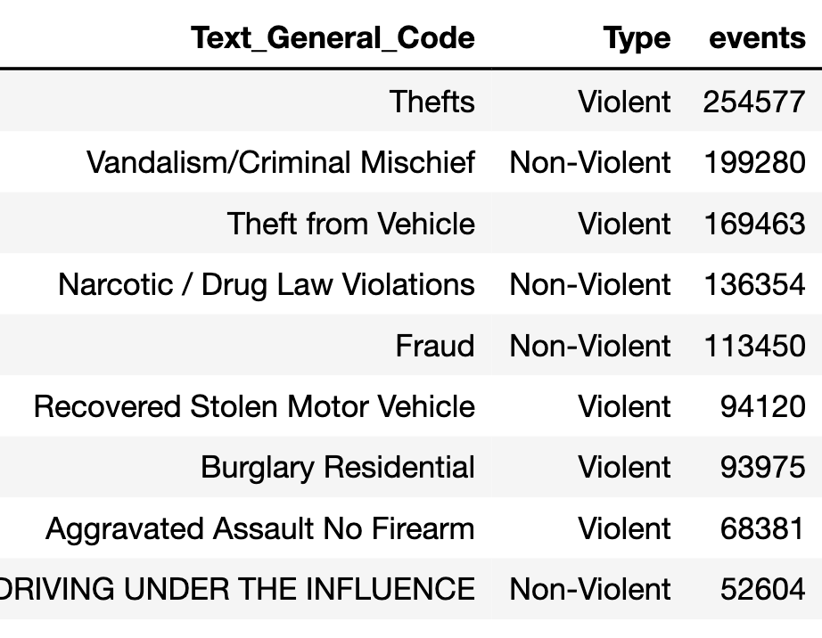
Exploratory data analysis (Top 10)
Are there any interesting correlations?

Slide 12
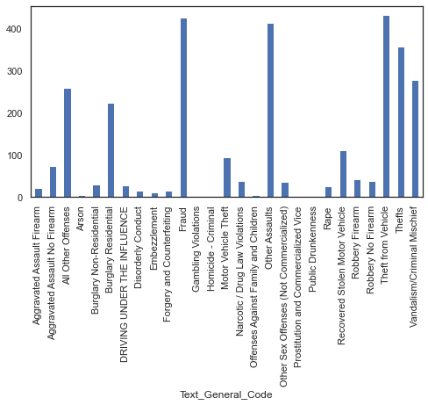
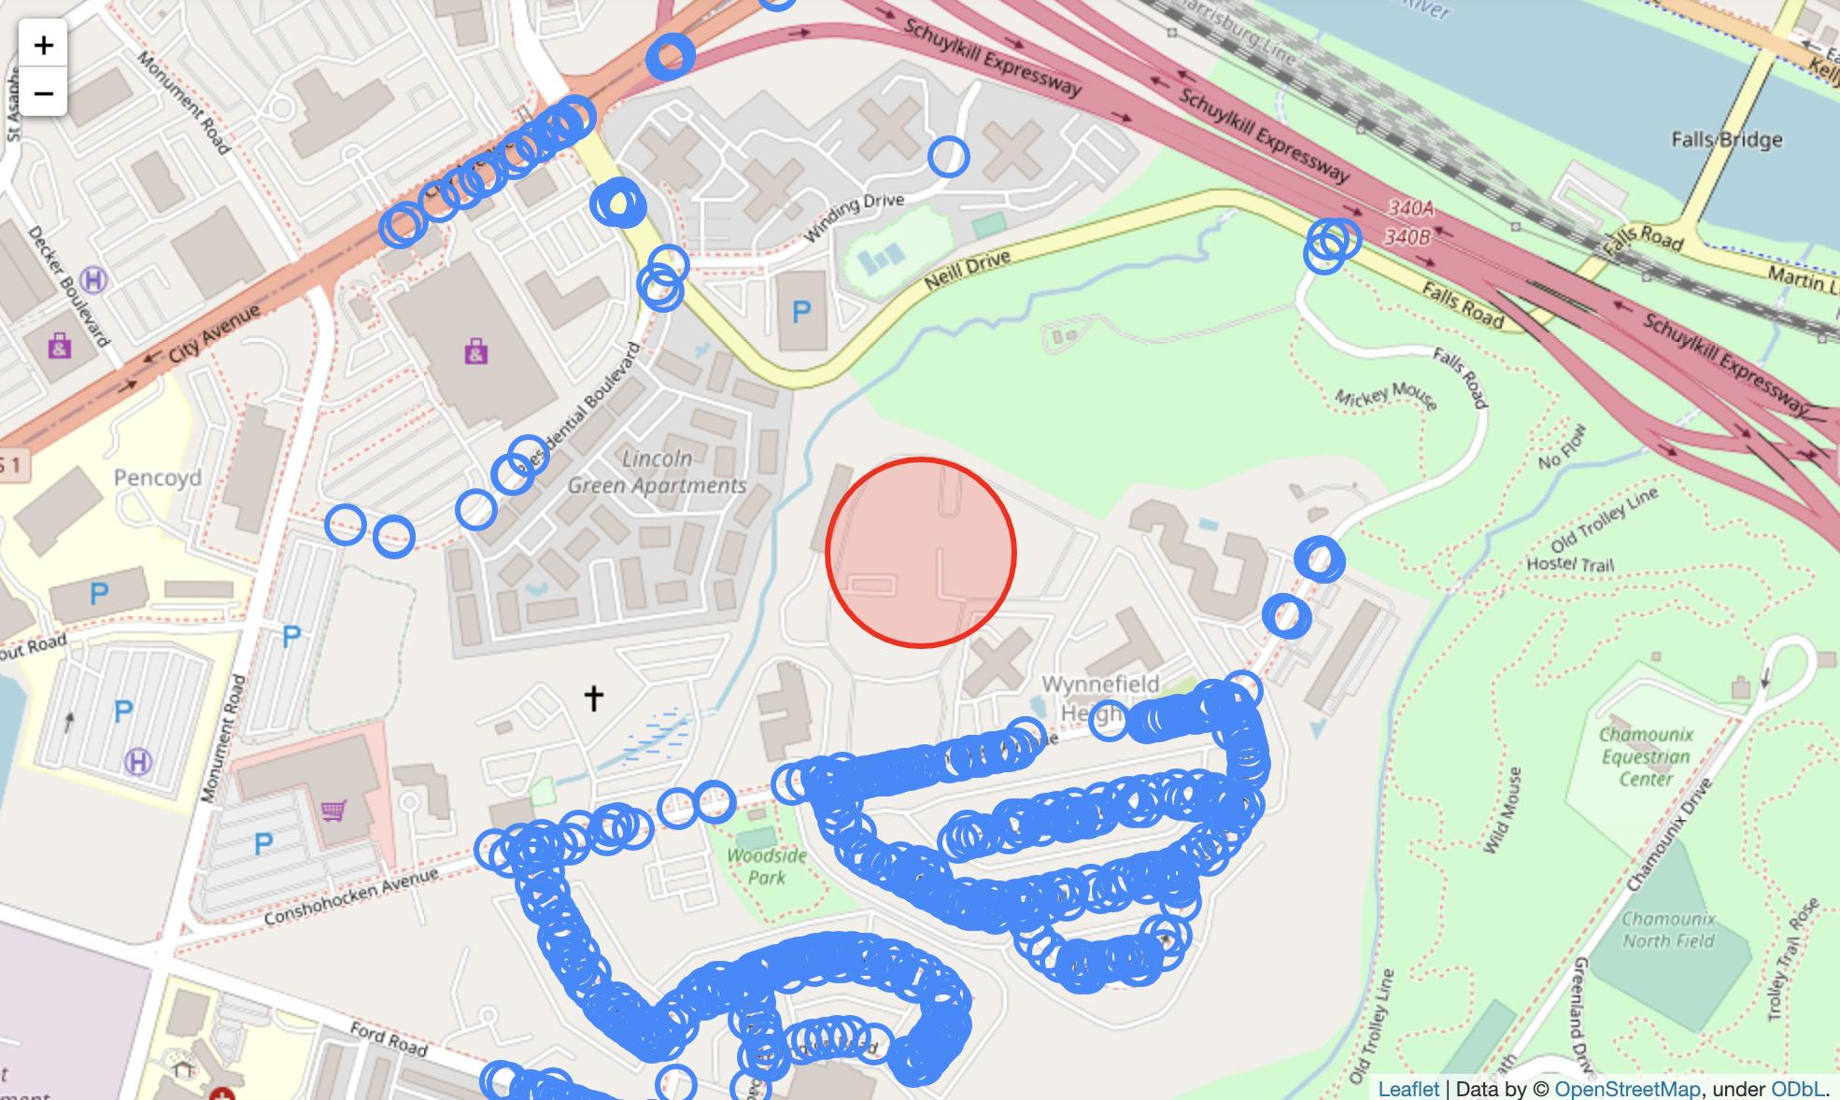
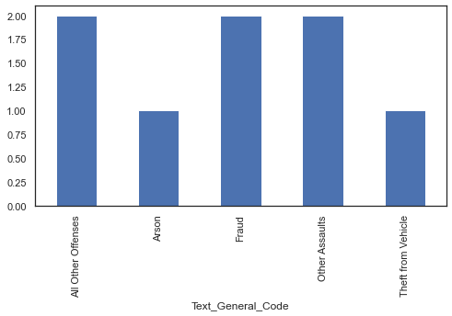
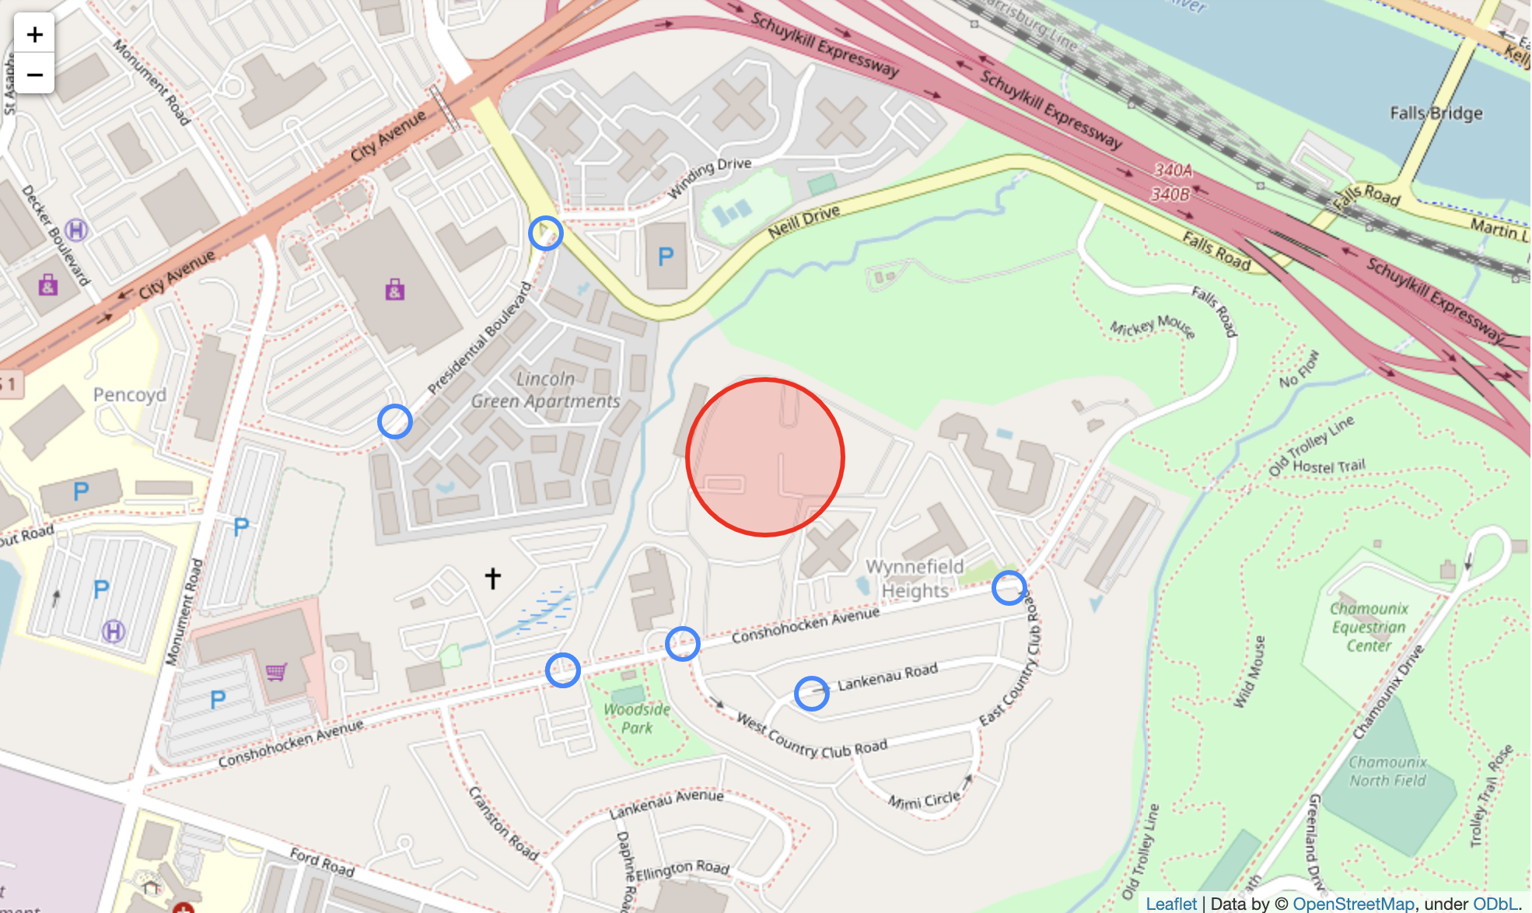
Machine Learning
KNN for the nearest 500
points and
type of crime that have
occurred
Notes:
Hong

Slide 13
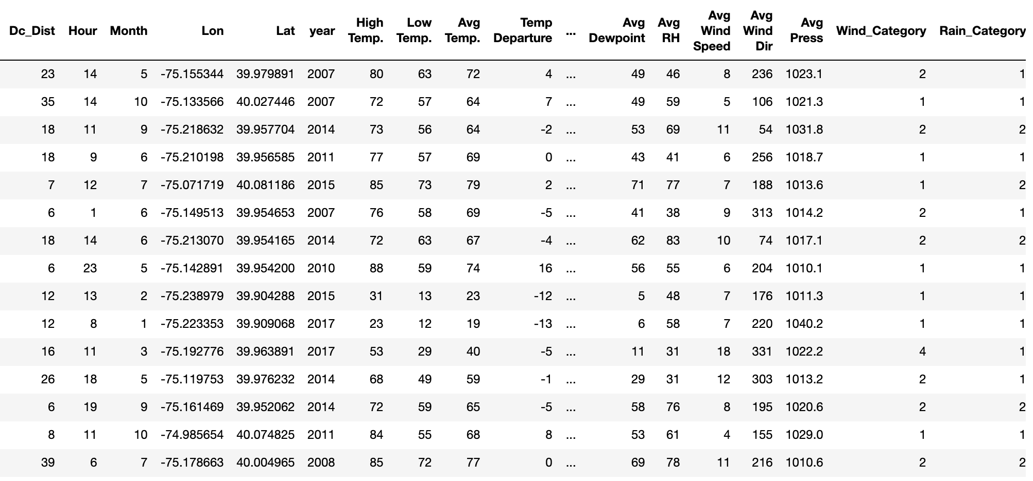
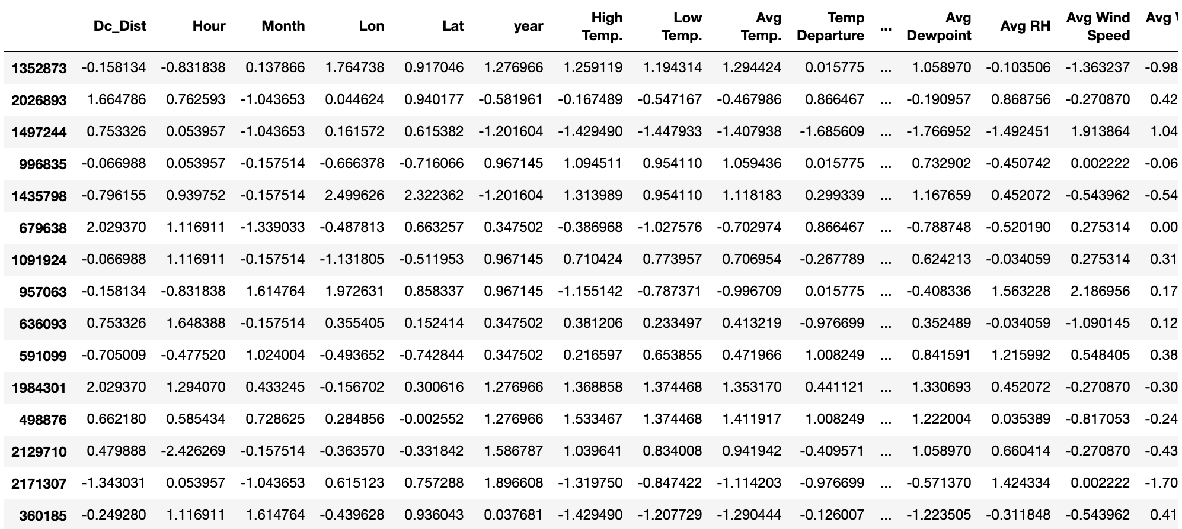
Machine Learning (cont.)
Normalizing the Dataset
so that each column consist of
numerical value between
-1 and 1

Slide 14
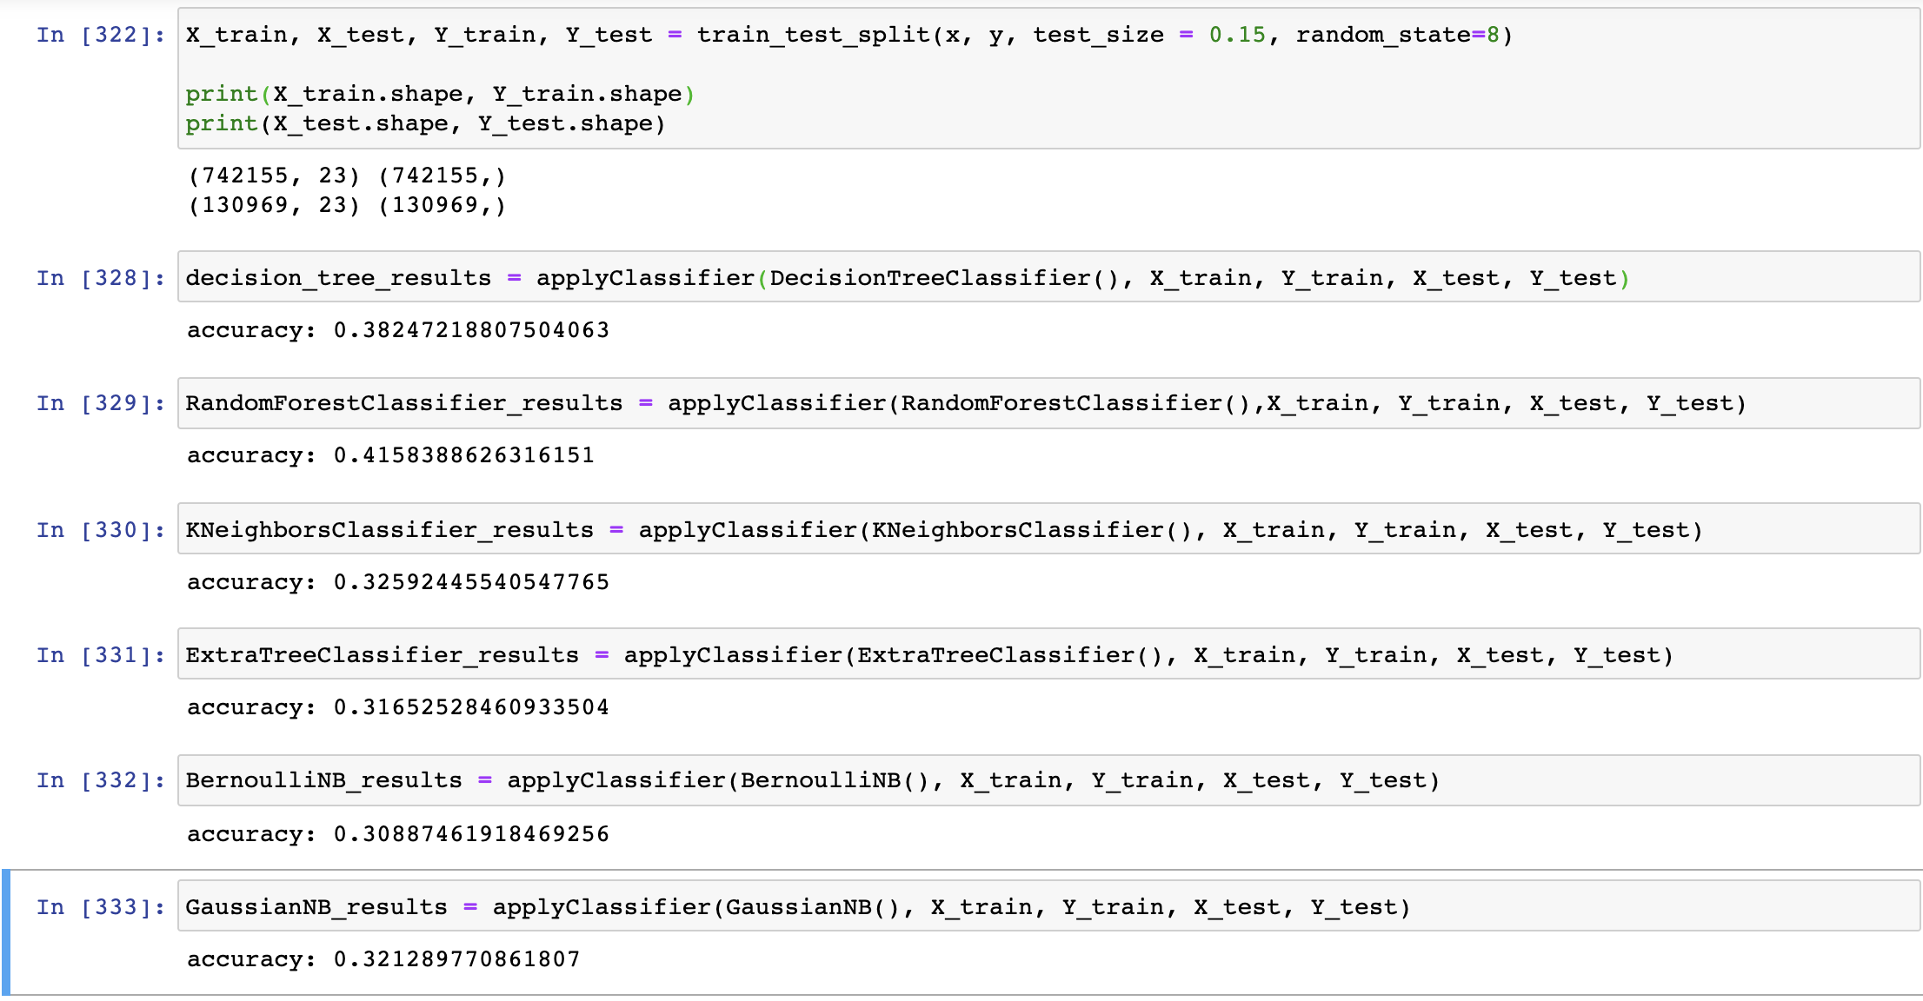
Machine Learning (cont.)
Applied different ML
classifiers and output
their accuracy.

Slide 15
Next Steps
Identify “important” features to help improve accuracy of models used
Integrate other attributes to ML models
Continue/Review ML models
Model Evaluation and make the model better
Predictive modeling report
Final Project Presentation
A Medium Article with Findings
Notes:
Hong

